Slide 1
Age, Income, and the Discounting of Delayed Monetary Losses Haoran (Matt) Wan

Slide 2
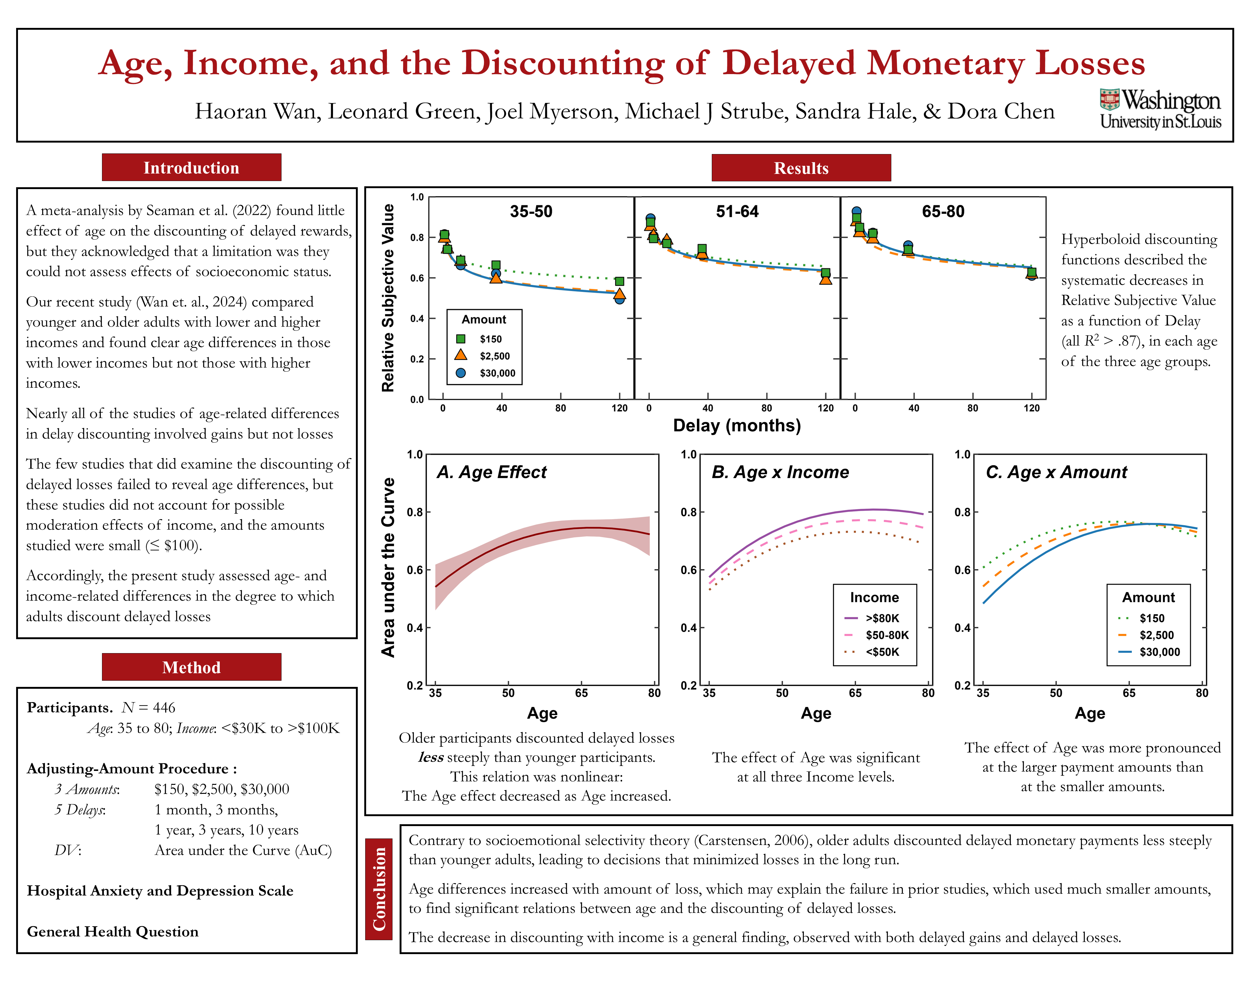

Slide 3
There is a lack of consensus in the literature as to whether there are age differences in
the discounting of delayed outcomes

Slide 4
There is a lack of consensus in the literature as to whether there are age differences in
the discounting of delayed outcomes
Seaman et al. (2022) reported that older adults tended to discount delayed gains less steeply than younger adults, although the difference was not sizeable

Slide 5
There is a lack of consensus in the literature as to whether there are age differences in
the discounting of delayed outcomes
Seaman et al. (2022) reported that older adults tended to discount delayed gains less steeply than younger adults, although the difference was not sizeable
Most of the studies in the meta-analysis did not
report socioeconomic status or income information

Slide 6
Our recent study (Wan et al., 2024) compared
how steeply younger and older adults with lower and higher incomes discounted delayed monetary gains
Older, lower income adults discounted delayed gains more shallowly than younger, lower income adults
However, no age difference was observed
among those with higher incomes

Slide 7
Nearly all of the studies of age-related differences
in delay discounting have involved gains
Studies that have examined the discounting of delayed losses have failed to reveal significant age-related differences
However, these studies did not account for
the possible moderation effect of income, and
the amounts used typically have been quite small (≤ $100)

Slide 8
Accordingly, the present study assessed
age- and income-related differences
in the degree to which adults discounted delayed losses

Slide 9
Method
N = 446 Age: 35-80; Income: <$30K - >$100K

Slide 10
Method
N = 446 Age: 35-80; Income: <$30K - >$100K
Adjusting-Amount Procedure
3 delayed amounts: $150, $2,500, $30,000.
5 delays: 1 month, 3 months, 1 year, 3 years, and 10 years

Slide 11
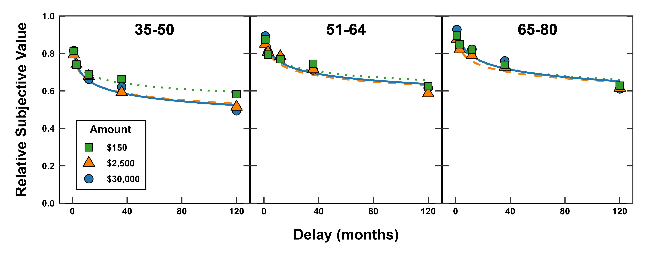
Hyperboloid discounting functions described the systematic decreases in Relative Subjective Value as a function of Delay (all R² > .87),
in each of the three age groups.

Slide 12
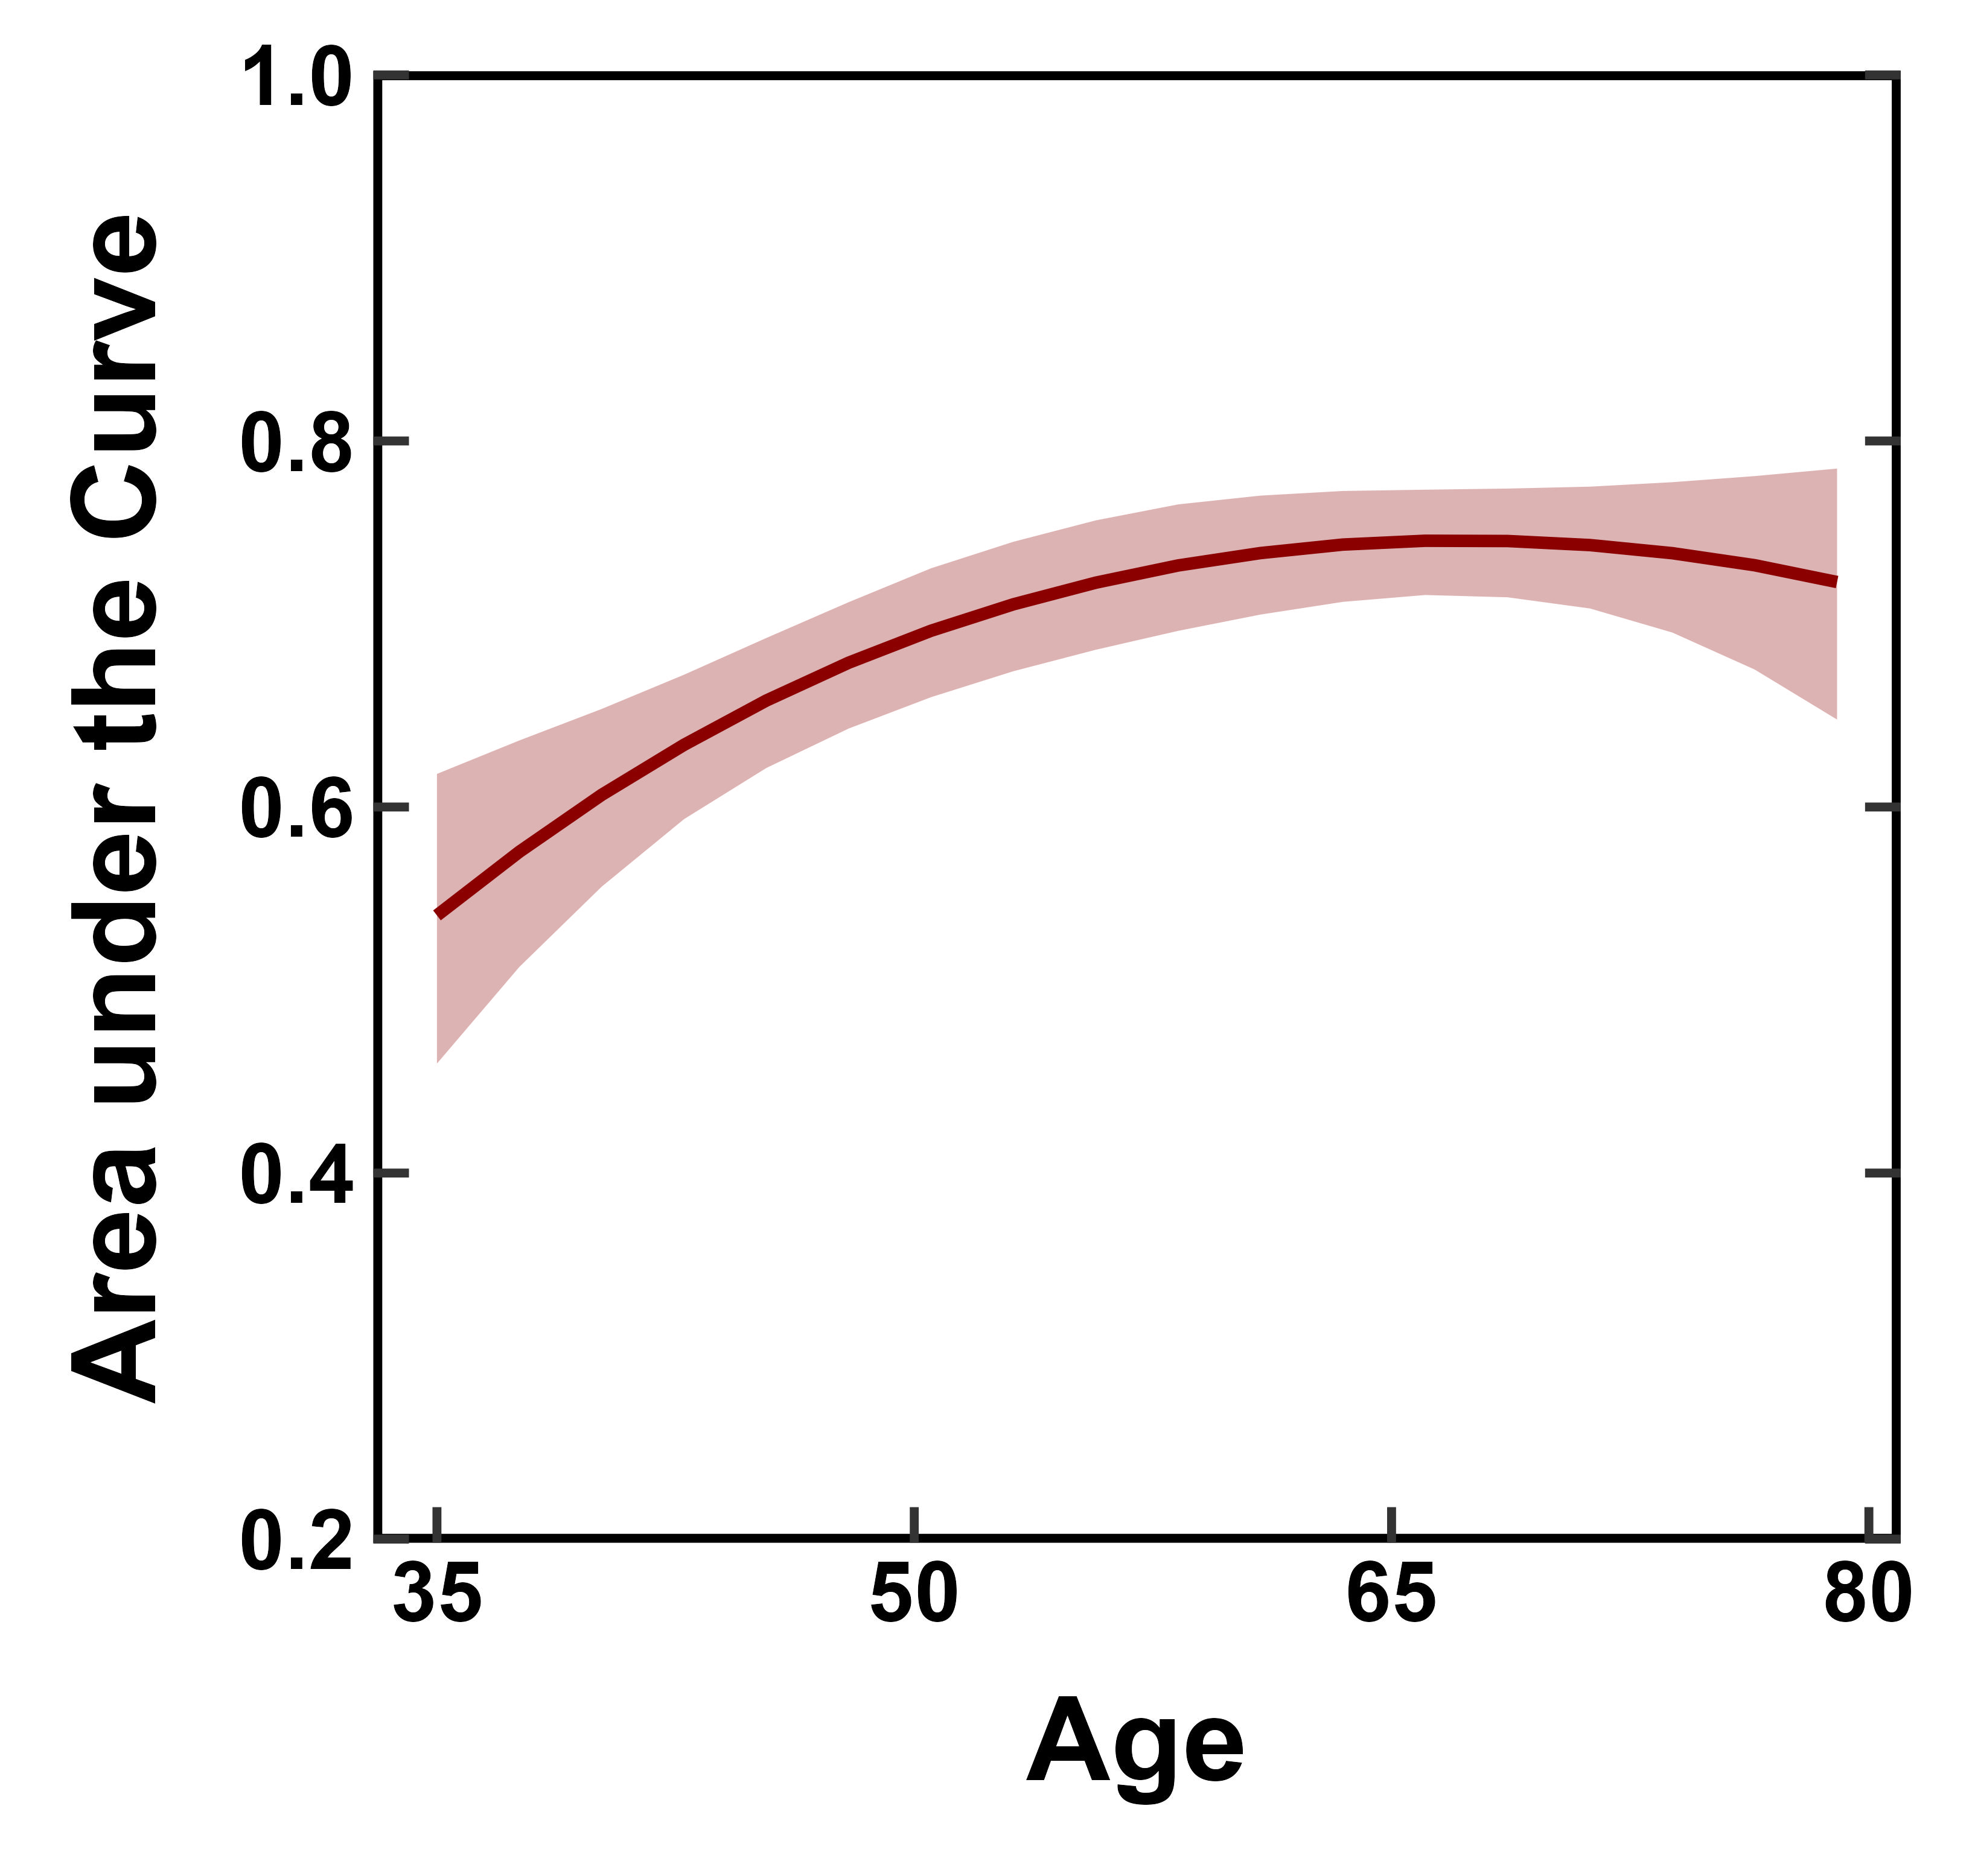
Older participants discounted delayed losses
less steeply than younger participants.
This relation was nonlinear:
The Age effect decreased as Age increased.

Slide 13
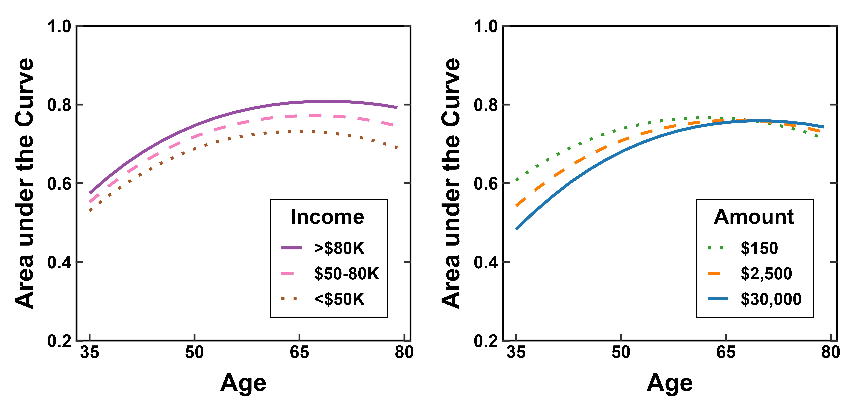
The effect of Age was more pronounced
at the larger payment amounts than
at the smaller amounts.
The effect of Age was significant
at all three Income levels.

Slide 14
Contrary to socioemotional selectivity theory (Carstensen, 2006), older adults discounted delayed losses less steeply than younger adults, leading to decisions that minimized losses in the long run.

Slide 15
Contrary to socioemotional selectivity theory (Carstensen, 2006), older adults discounted delayed losses less steeply than younger adults, leading to decisions that minimized losses in the long run.
Age differences increased with amount of loss, which may explain the failure in prior studies, which used much smaller amounts, to find significant relations between age and the discounting of delayed losses.

Slide 16
Contrary to socioemotional selectivity theory (Carstensen, 2006), older adults discounted delayed losses less steeply than younger adults, leading to decisions that minimized losses in the long run.
Age differences increased with amount of loss, which may explain the failure in prior studies, which used much smaller amounts, to find significant relations between age and the discounting of delayed losses.
The decrease in discounting with income is a general finding,
observed with both delayed gains and delayed losses.

Slide 17
Thank you!

